Slide 1

TELECOM CHURN PREDICTIONS
Name: BharathRaj R
Batch: 116

Slide 2
Table of Contents
1. Problem statement
1.1. Introduction
1.2. Obejctives
1.3. Dataset Features
2. Import Libraries and Data
3. Handling Missing Values
4. Data Analysis and Visualization
5. Outlier Detection
6. Categorical Variables Encoding
7. Balance Data
8. Dataset Splitting
9. Feature Scaling
10. Modeling and Parameter Optimization
11. Feature Importance
12. Results
13. deployment using streamlet

Slide 3
1. Problem Statement
1.1. Introduction
What is Customer Churn?
Customer churn is the percentage of customers that stopped using company's product or service during a certain time frame. Customer churn is one of the most important metrics for a growing business to evaluate as it is much less expensive to retain existing customers than it is to acquire new customers. Customers in the telecom industry can choose from a variety of service providers and actively switch from one to the next. The telecommunications business has an annual churn rate of 15-25 percent in this highly competitive market.

Slide 4
1.2. Obejctives
In this projects below questions will be answered:
What's the % of Customers Churn and customers that keep in with the active services?
Is there any patterns in Customers Churn based on the gender?
Is there any patterns/preference in Customers Churn based on the type of service provided?
What's the most profitable service types?
Which features and services are most profitable?
Which features have the most impact on predicting customers churn?
Which model is the best for predicting churn?

Slide 5
Dataset
Source dataset is in .xlsx format, converted to csv format.
Train dataset contains of 7043 rows and 21 columns.
Test dataset contains of 20 rows and 19 columns.
Churn is a variable which notifies whether a particular customer is churned or not.

Slide 6
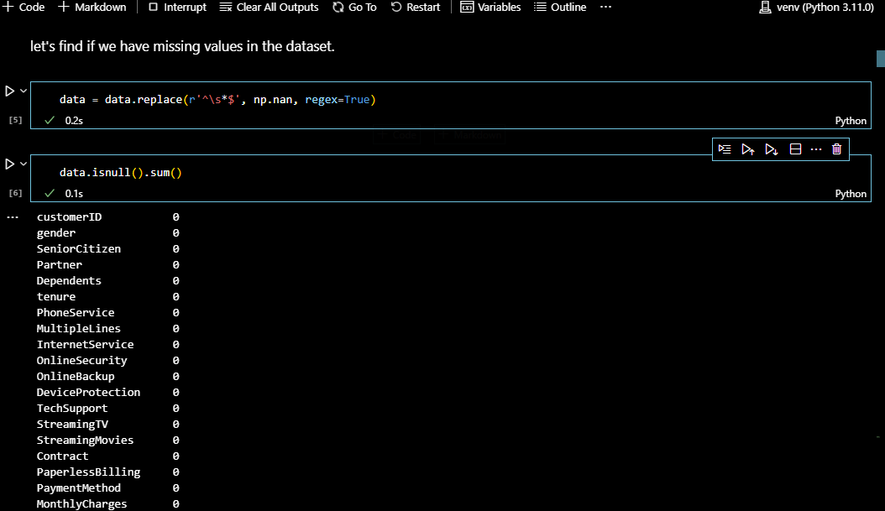
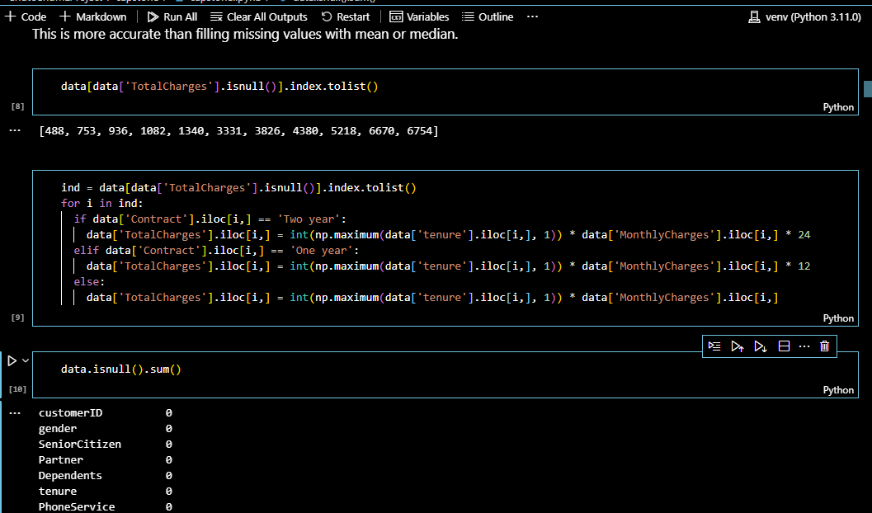
Handling Missing Values

Slide 7
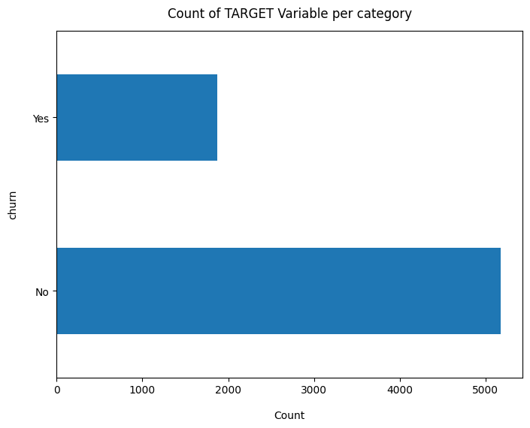
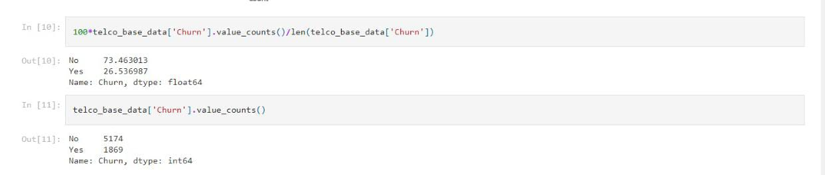
Data Analysis and Visualization
Churn Ratio
Data is highly imbalanced, ratio = 73:27
So we analyse the data with other features while taking the target values separately to get some insights.

Slide 8
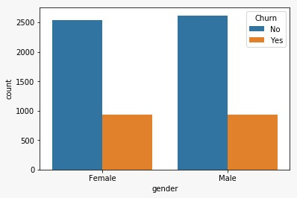
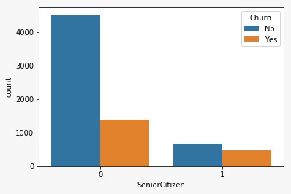
* We have imbalanced data.
* 26.6 % of customers switched to another company.
* Customers are 49.5 % female and 50.5 % male.

Slide 9
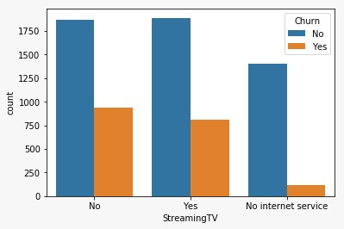
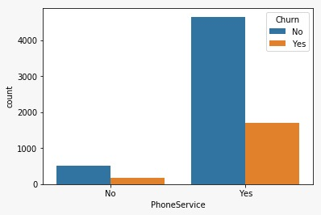
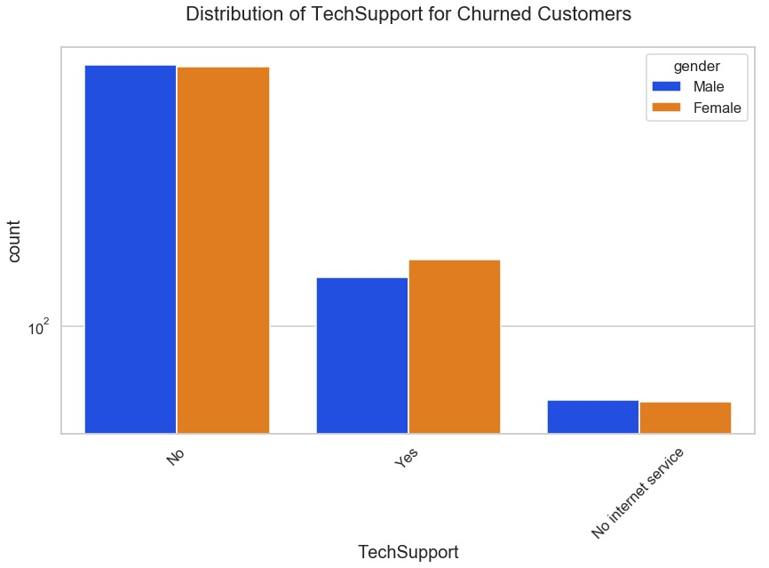

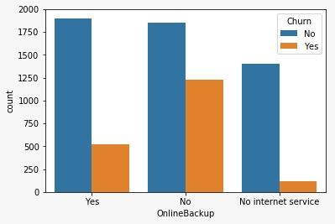
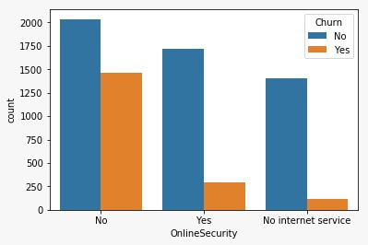
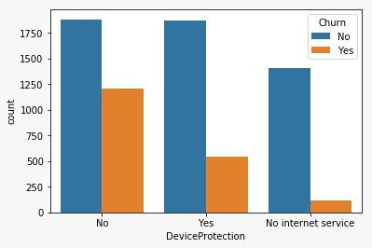
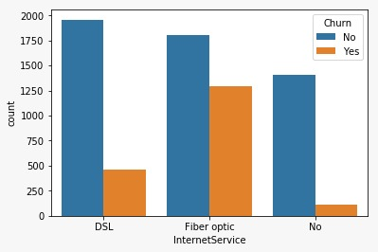
Services

Slide 10
* There is negligible difference in customer percentage who changed the service provider. Both genders behaved in similar way when it comes to migrating to another service provider.
* About 43% of customer with Month-to-Month Contract opted to move out as compared to 11% of customrs with One Year Contract and 3% with Two Year Contract. A major percent of people who left the comapny had Month-to-Month Contract. This is acutually logical since people who have long-term contract are more loyal to the company.
* Major customers who moved out had Electronic Check as Payment Method.
* Customers who chose Credit-Card automatic transfer or Bank Automatic Transfer and Mailed Check as Payment Method were less likely to move out.

Slide 11
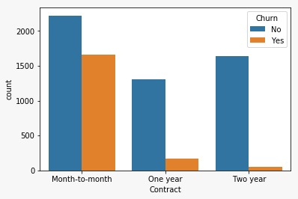

Slide 12
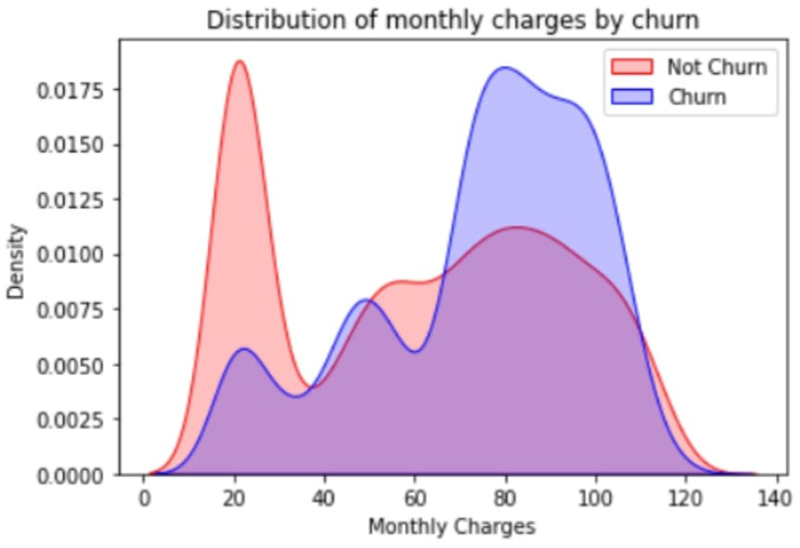
CHURN BY MONTHLY CHARGES
Higher % of customers churn when the monthly charges are high

Slide 13
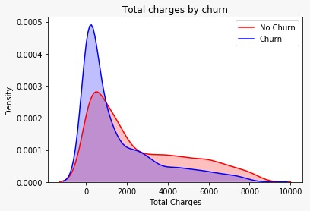
CHURN BY TOTAL CHARGES
High churn at low total churn

Slide 14
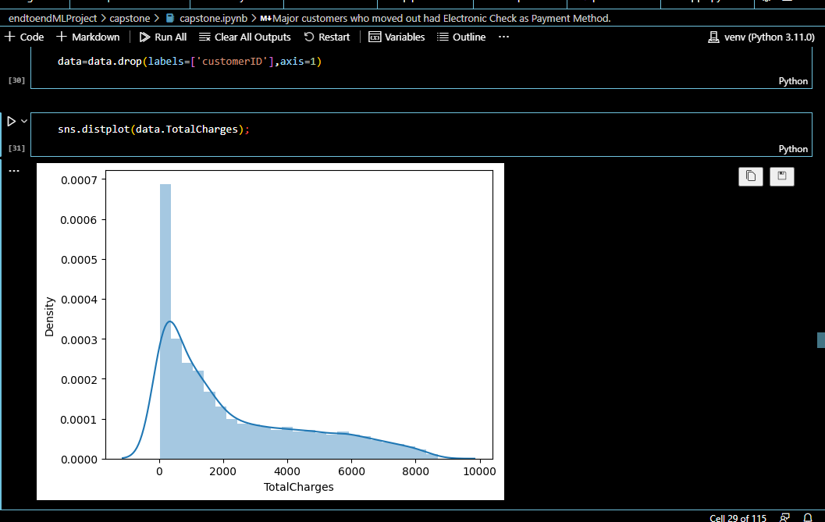
Outlier Detection
There is no outlier.

Slide 15
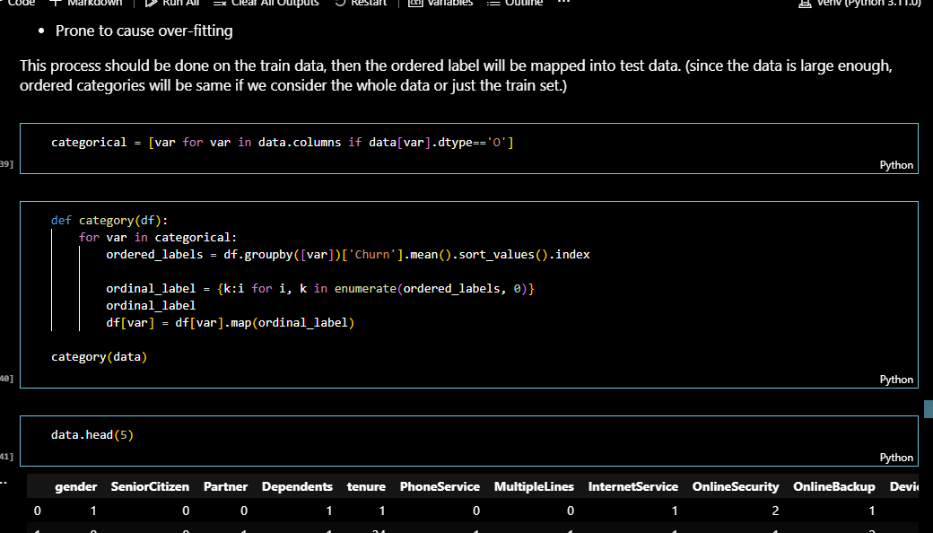
Categorical Variables Encoding

Slide 16
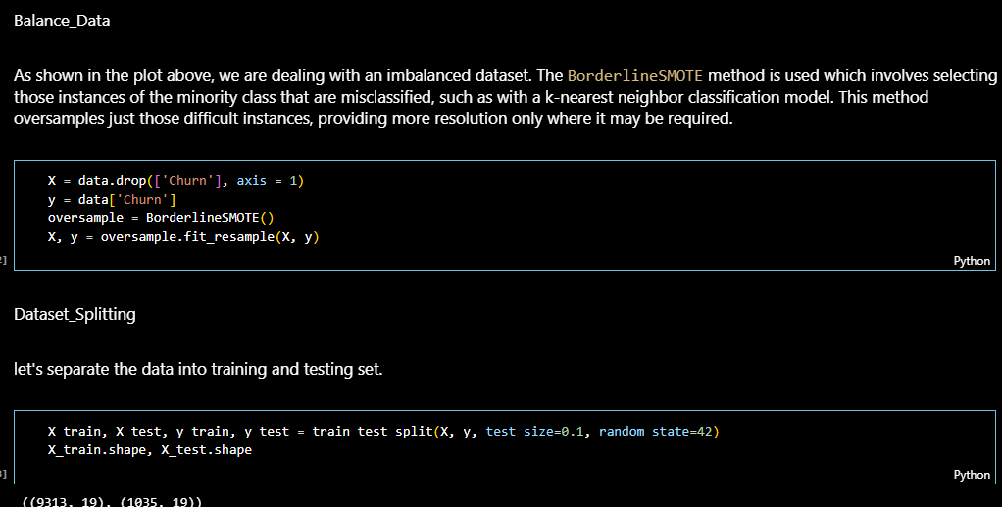
Balance Data

Slide 17
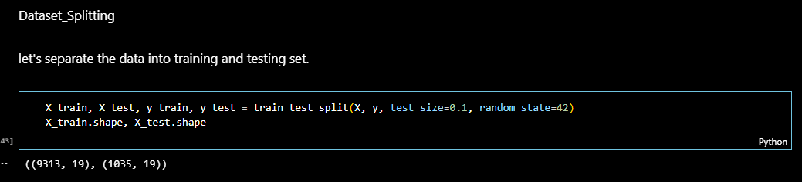
Dataset Splitting

Slide 18
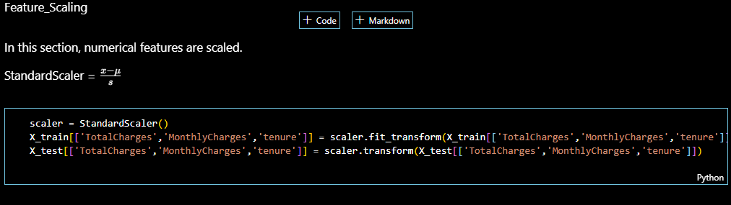
Feature Scaling

Slide 19
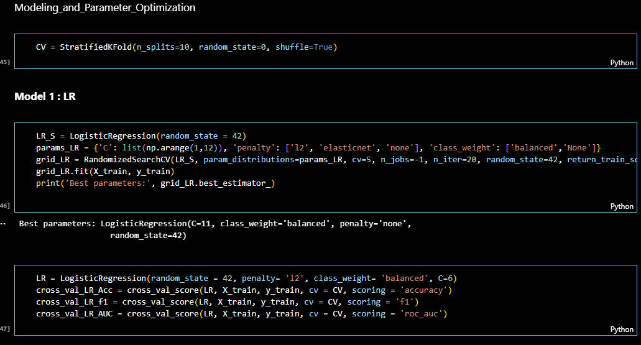
Modeling and Parameter Optimization

Slide 20
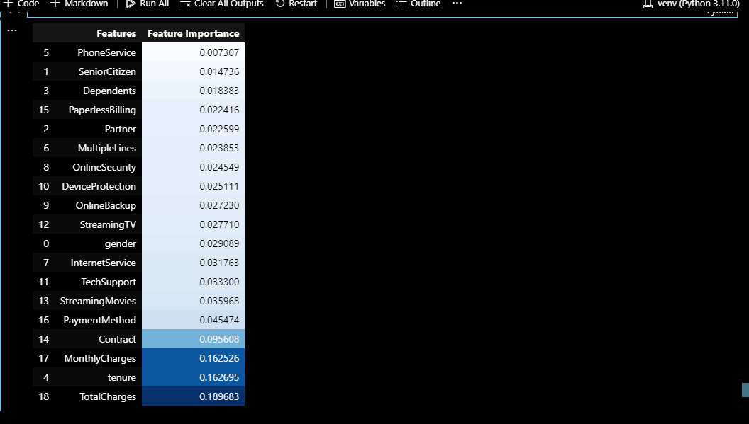
Feature Importance

Slide 21
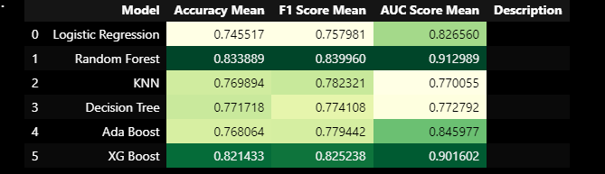
Results

Slide 22
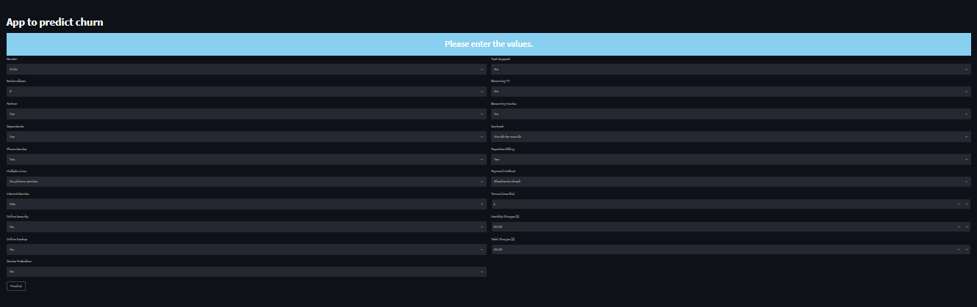
deployment using streamlit

Slide 23
Thank you

